Slide 1

第十二讲 宏观进化分析 (1)
王志恒
北京大学城市与环境学院
zhiheng.wang@pku.edu.cn

Slide 2

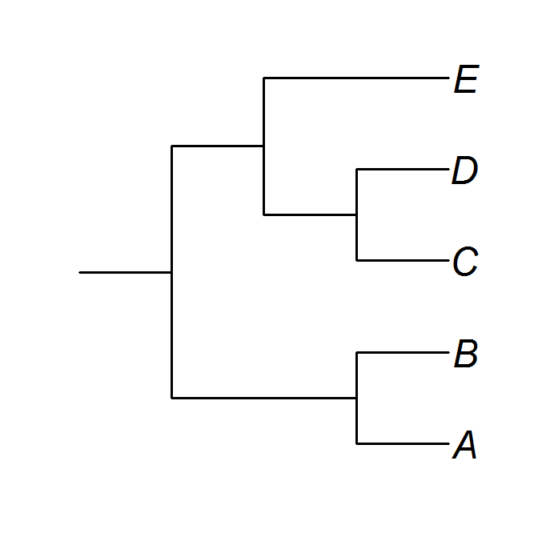
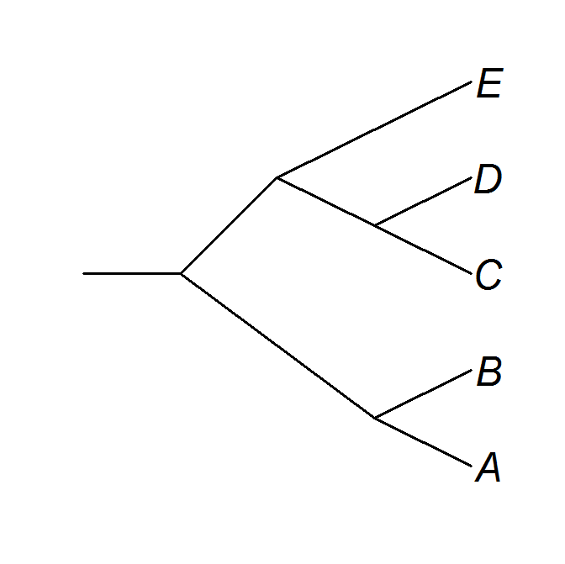
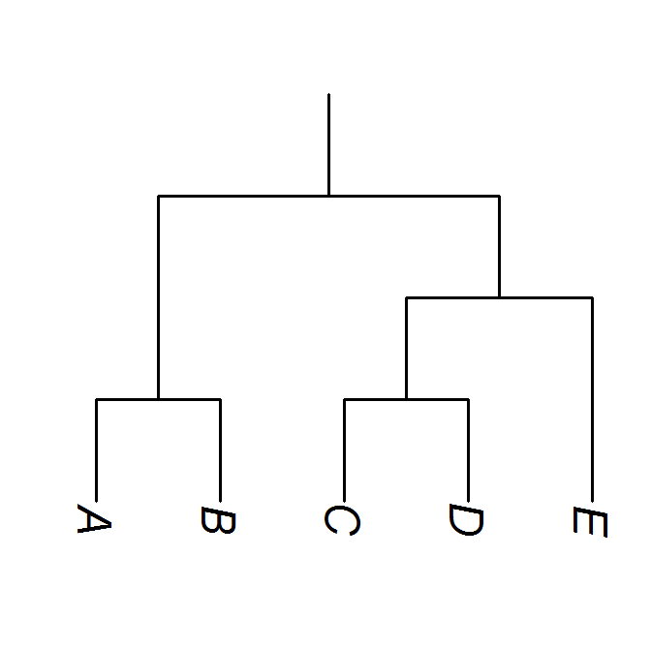
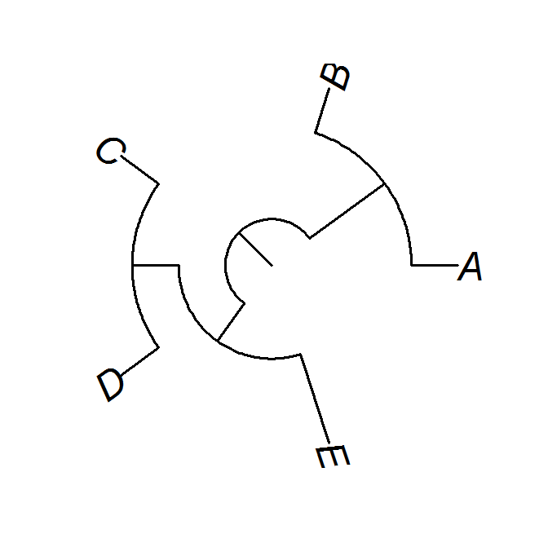
谱系
Phylogeny/tree
广义：具有历史发展沿袭关系的事物形成的系统或关系。如家谱上的系统
谱系树
系统进化树
分支树
种系发生树
系统发生树
生物学：物种（或类群）间的进化关系，通常根据分子序列和表型的相似性或差异程度进行推断。

Slide 3
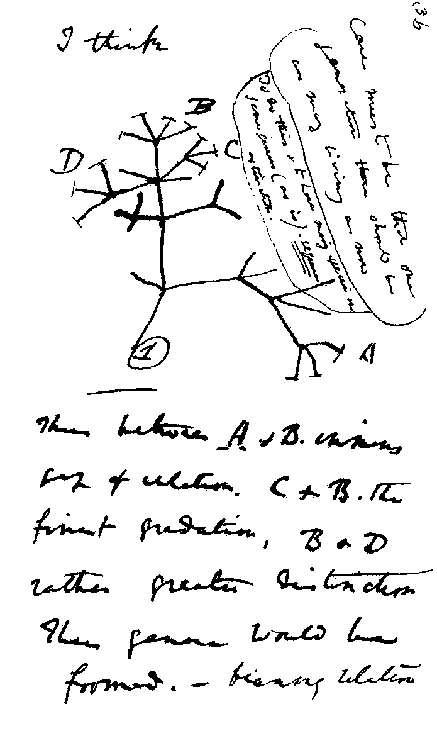
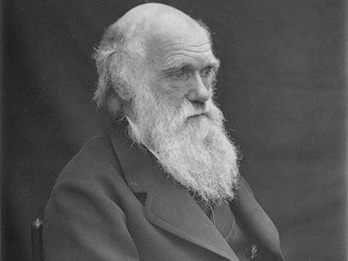
The first evolutionary tree by Charles Darwin
Charles Darwin, 1837

Slide 4
关于谱系的几个名词
枝
中间节点
末端节点
根节点
枝长
枝长
根结点(root)：该谱系树所包含的所有物种（或类群）的共同祖先
中间结点(node)： 表示分化事件，或其后代的最近共同祖先
枝(branch)： 连接相邻两个结（节）点的线
末端节点(tip, terminals, leaf )：现存物种

Slide 5
关于谱系的几个名词
内类群
ingroup
分枝
外类群
outgroup
内类群(ingroup) vs. 外类群(outgroup)
分枝(clade)：谱系树的一部分，包括由一个共同祖先衍生的所有后代

Slide 6
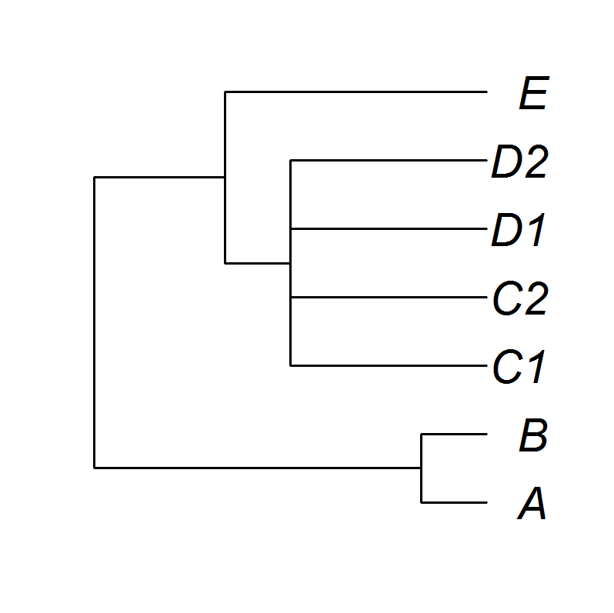
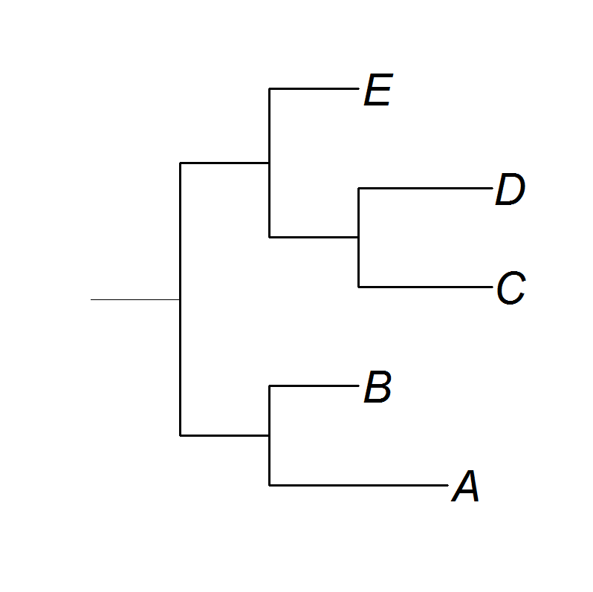
关于谱系的几个名词
多歧分支
超度量谱系(Ultrametric phylogeny)：所有末端节点到根节点的距离都相同
判断是否超度量谱系：ape package
is.ultrametric

Slide 7
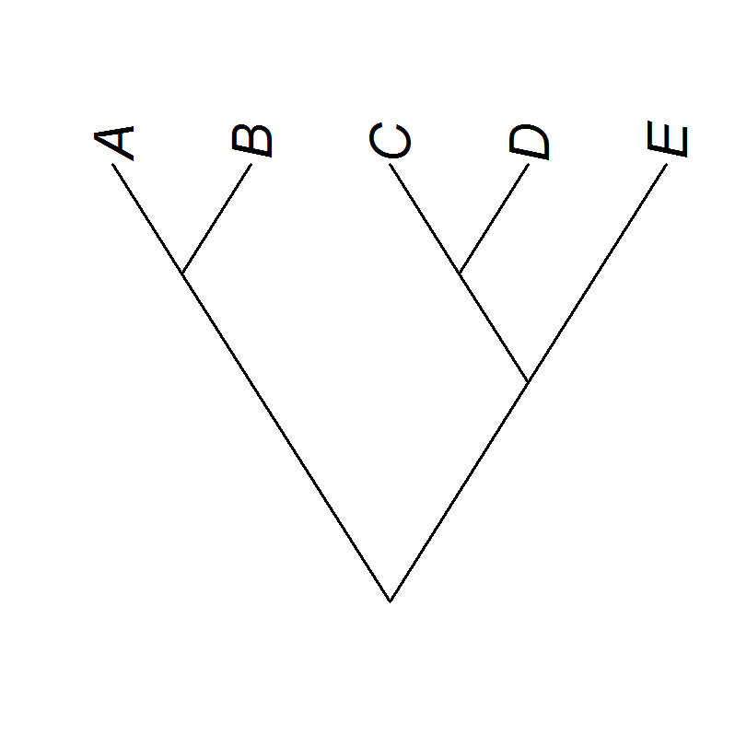
关于谱系的几个名词
单系类群(monophyletic group)：包含一个最近祖先的所有后裔
并系类群(paraphyletic)：仅包括一个最近祖先的部分后裔
多系类群(polyphyletic)：由趋同进化导致的、在谱系上相隔着其他分支的类群

Slide 8
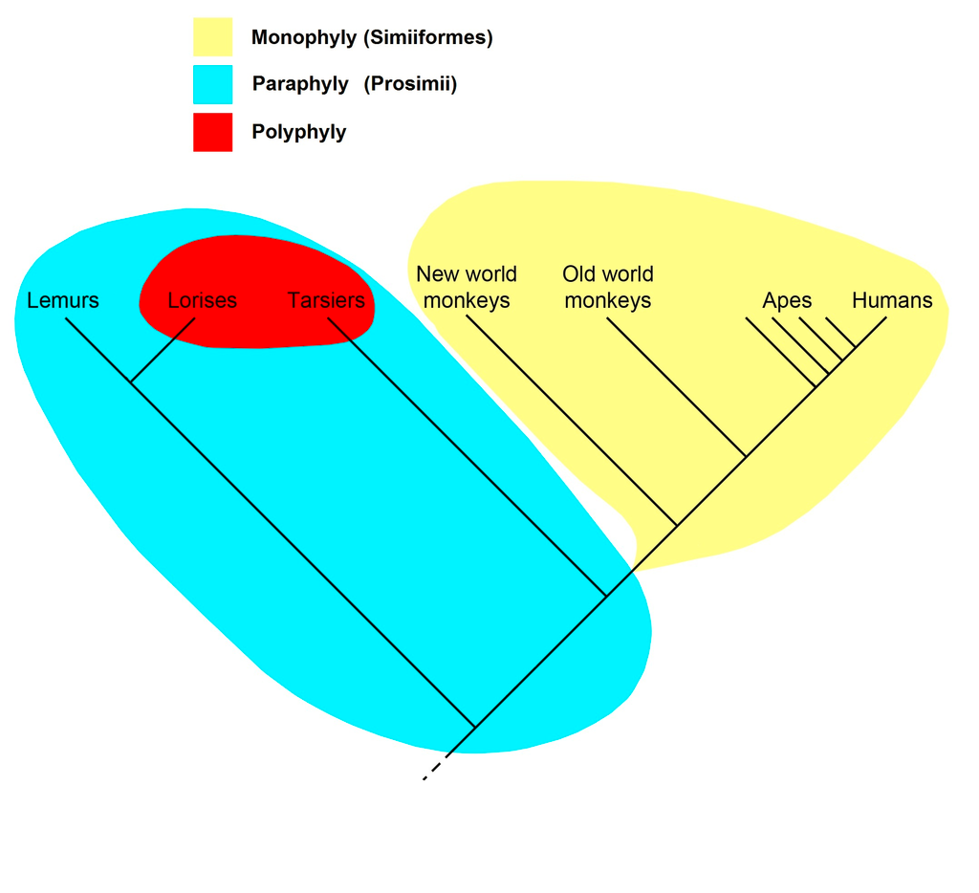
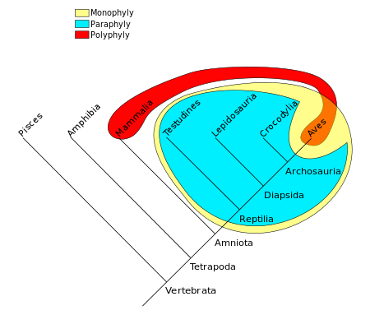
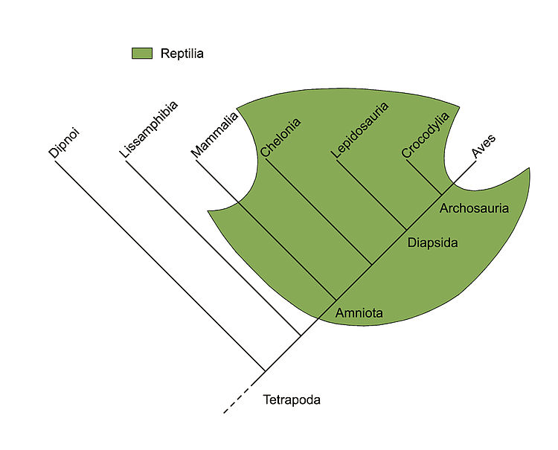
比如C4植物、固氮植物等。
判断是否单系：ape package
is. monophyletic
狐猴
懒猴
眼镜猴
有鳞类
鳄类
哺乳类
龟鳖
鸟类
固氮植物

Slide 9
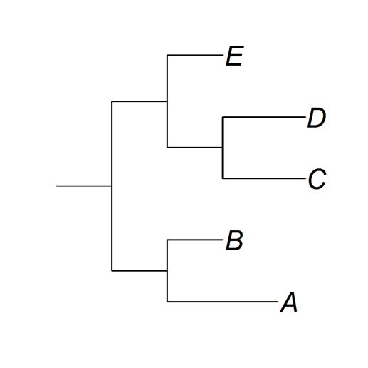
关于谱系的几个名词
枝长
枝长
枝长
枝长
突变数量
进化时间

Slide 10
Phylogenetic diversity indices
Faith phylogenetic diversity (Faith PD): the length of the minimum spanning tree
Total taxonomic distinctness (TTD): the sum of pairwise phylogenetic distances
Average taxonomic distinctness (AvTD): average of the phylogenetic distances between all species pairs
Mean root distance (MRD): average of the number of nodes separating each species from the root
Phylogenetic species variability (PSV)
Phylogenetic species richness (PSR)
Phylogenetic species evenness (PSE)

Slide 11
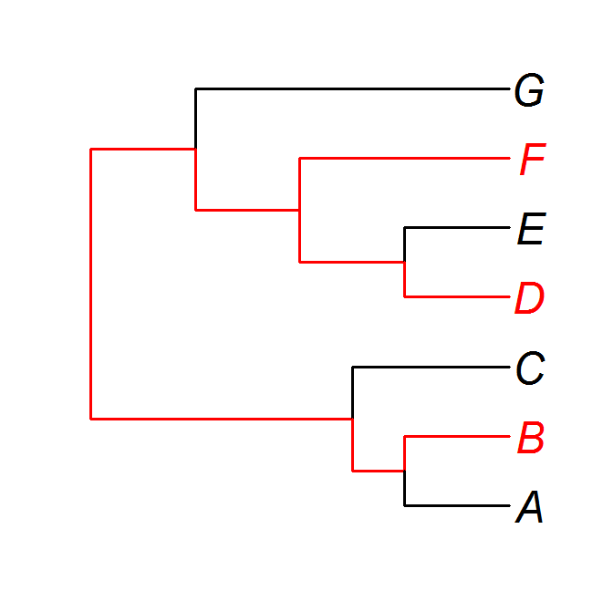
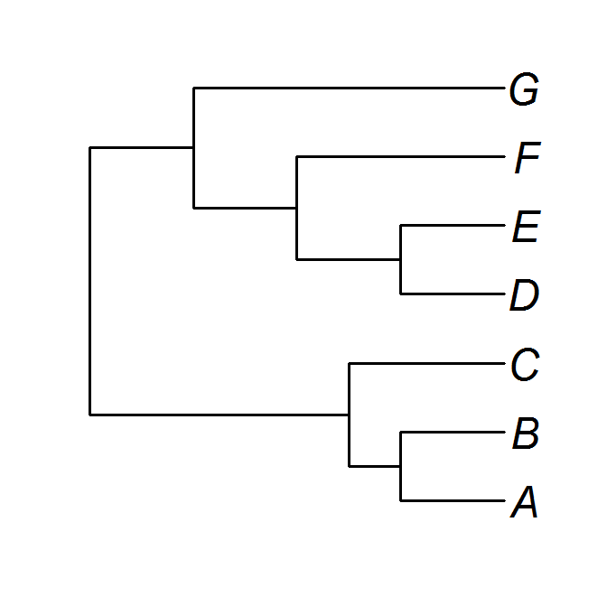
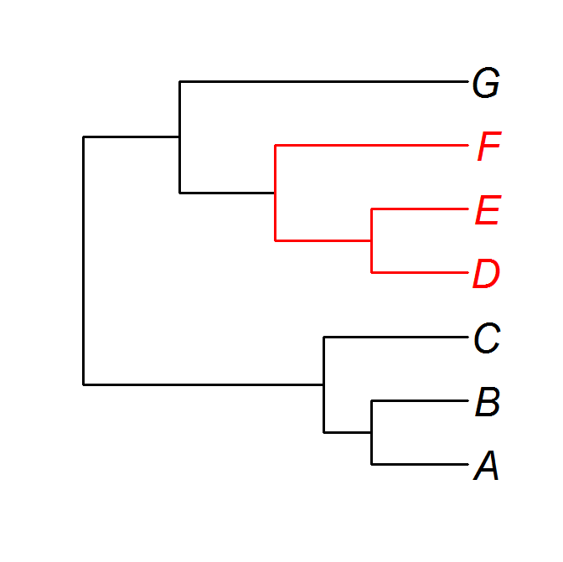
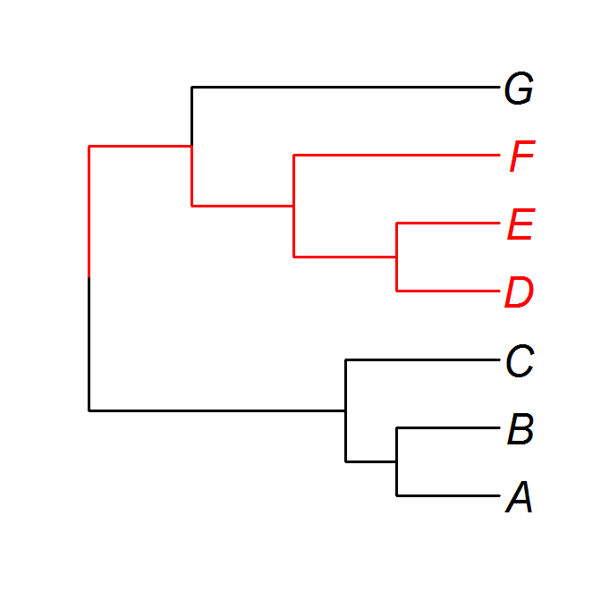

Phylogenetic diversity indices
Faith phylogenetic diversity (Faith PD): the length of the minimum spanning tree
最小生成树的总长度
群落
群落
×
L7
L8
×
L6
L5
L4
L3
L1
L2
$$PD=\sum_{i=1}^{8}{Li}$$

Slide 12
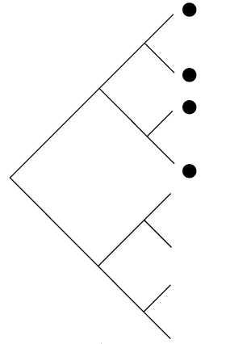

Phylogenetic diversity indices
a
Mean root distance (MRD): average of the number of nodes separating each species from the root
平均根距离
b
c
d
RD_{a} = 3
RD_{b} = 3
MRD = 3
RD_{c} = 3
RD_{d} = 3

Slide 13
Phylogenetic diversity indices
a
Total taxonomic distinctness (TTD): the sum of pairwise phylogenetic distances (总分类特异性？？)
Average taxonomic distinctness (AvTD): average of the phylogenetic distances between all species pairs (平均分类特异性？？)
b
c
d
TTD = 0.5×Σd(i, j), i ≠ j
AvTD = 2×TTD/[n×(n-1)]
d(i, j): phylogenetic distance between species i and j
n: number of species
Mean phylogenetic distance (MPD)
MPD = Σd(i, j)/(n×(n-1))
Clarke & Warwick, 1998

Slide 14
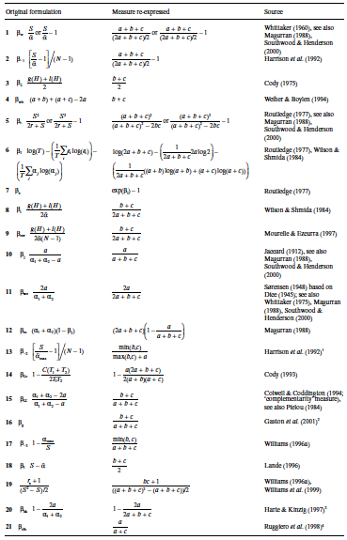
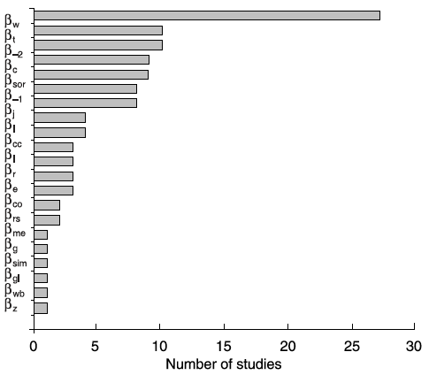
Measures of Beta Diversity
Koleff et al. (2003) Journal of Animal Ecology

Slide 15
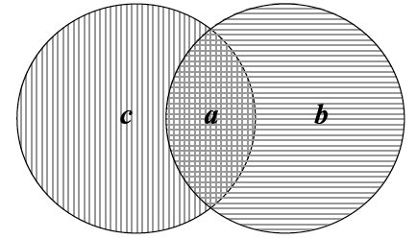

Measures of Beta Diversity
Sørensen beta diversity, β_{sor}
Β_{sor} = 1 -

Slide 16
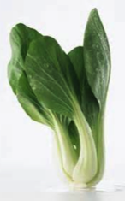


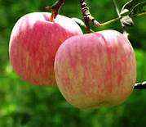

Taxonomic β vs. phylogenetic β
Taxonomic β: turnover in species composition between sites
b4
b5
b1
b2
b3
a = b = c = 1
=
=
=
=1-(2*1)/(1+1+2*1) = 0.5
Sp richness = 2
Sp richness = 2

Slide 17
Taxonomic β vs. phylogenetic β
Taxonomic β: turnover in species composition between sites
b4
b5
b1
b2
b3
=
=
=
Sp richness = 2
Sp richness = 2

Slide 18
Taxonomic β vs. phylogenetic β
Phylogenetic β: turnover in clade composition between sites
b4
b5
b1
b2
b3
a = b1+b4
b = b2
c = b3 + b5
≠
≠
≠
<
Sp richness = 2
Sp richness = 2

Slide 19
Ecological null hypothesis
A hypothesis is a statement about data:
“A null hypothesis entertains the possibility that nothing has happened, that a process has not occurred, or that change has not been produced by a cause of interest. Null hypothesis are reference points against which alternatives should be contrasted"
(Strong 1980).

Slide 20
Ecological null hypothesis
Example 1: Nutrient addition experiment
H₀: There is no effect of fertilization. Growth rate is identical for experiment and control plots.
H₁: There is a measurable effect.
A statistical test (e.g. ANOVA) is applied to reject or not reject the null hypothesis. Erecting hypothesis is a way to answer questions.

Slide 21

Ecological null models
A null model is a practical tool :
"A null model is a pattern-generating model that is based on randomization of ecological data or random sampling from a known or imagined distribution.”
(Gotelli and Graves 1996)
零模型是一个工具：零模型是通过对生态学数据进行随机化或对已知的分布进行随机重采样来生成生态格局的一类模型。

Slide 22
Ecological null model
“The null model is designed with respect to some ecological or evolutionary process of interest…
The randomization is designed to produce a pattern that would be expected in the absence of a particular ecological mechanism”
(Gotelli and Graves 1996)

Slide 23
Ecological null model
…a null model does not provide an answer, it is not directly associated with a test.
It provides material, an artificial dataset with which we can compare the empirical. A challenge lies in constructing the appropriate null model and subsequently applying an appropriate test to the data.

Slide 24

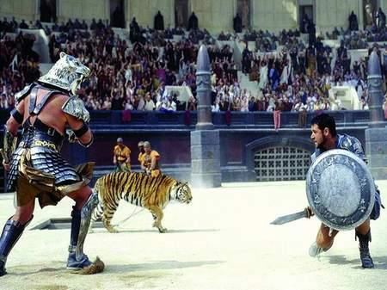
Community assembly competition-driven vs. filter-driven

Slide 25
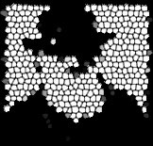
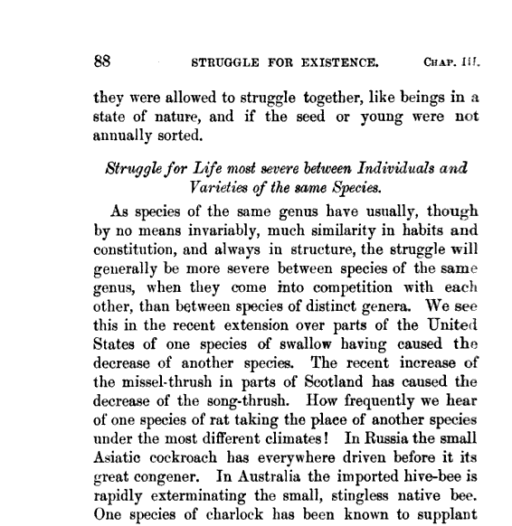

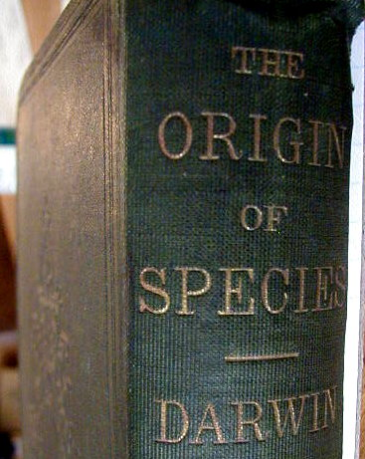


The classic view
假设：亲缘关系比较近的物种具有相近的功能属性和生态位
同属物种通常具有相似的习性和结构，因而相互之间的竞争比不同属物种间更激烈
Charles Darwin

Slide 26

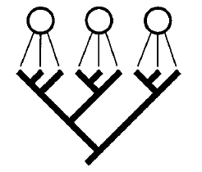
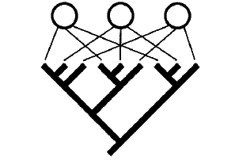
热点：群落谱系(community phylogenetics)
群落
谱系
谱系聚集
谱系发散
环境筛选
竞争排除

Slide 27
Phylogenetic structure: clustered or overdispersed?
Mean phylogenetic distance (MPD)
MPD = Σd(i, j)/(n×(n-1))
d(i, j): phylogenetic distance between species i and j
n: number of species

Slide 28
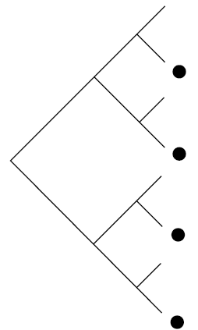
Phylogenetic structure: clustered or overdispersed?
clustering
overdispersion
Net relatedness index (NRI)
NRI = -(MPD_{obs} - meanMPD_{n})/sdMPD_{n}
MPD_{obs}: mean phylogenetic distance in a grid cell with n species
meanMPD_{n} : mean MPD of 1000 assemblages with n species randomly drawn from the global species pool
sdMPD_{n} : standard deviation MPD of 1000 assemblages with n species randomly drawn from the global species pool

Slide 29
Phylogenetic structure: clustered or overdispersed?
overdispersion
clustering
Frequency
-1.96
0
1.96
NRI
谱系发散
谱系聚集
Positive NRI: clustered; NRI > 1.96: significantly clustered
Negative NRI: overdispered: NRI < - 1.96: significantly overdispersed

Slide 30

热点：群落谱系(community phylogenetics)
C1: clustered, NRI > 1.96
C2: over-dispersed, NRI < -1.96
C3: random, NRI介于-1.96 – 1.96之间

Slide 31
Phylogenetic structure: clustered or overdispersed?
Mean nearest phylogenetic taxon distance (MNTD)
MNTD = ΣD_{i}/n
D_{i}: phylogenetic distance between species i and its closest taxon
n: number of species

Slide 32
Phylogenetic structure: clustered or overdispersed?
clustering
overdispersion
Phylogenetic Nearest Taxon Index (NRI)
NTI = -(MNTD_{obs} - meanMNTD_{n})/sdMNTD_{n}

Slide 35
Phylogenetic diversity indices
Evolutionary distinctness (ED, 进化特异性？？)
枝长/物种数
群落总进化特异性
群落平均进化特异性
GE: IUCN受威胁等级权重。Least concern, 0; Near threatened, 1; Vulnerable, 2; Endangered, 3; Critically endangered, 4
Isaac et al. (2007) PloS ONE

